Slide 1
Understanding Distributions
25/3/2019

Slide 2
Learning Objectives
Theory of Distribution.
Types and characteristics of Distribution.
Why it is important to the world of analytics.
Standard distribution.

Slide 3
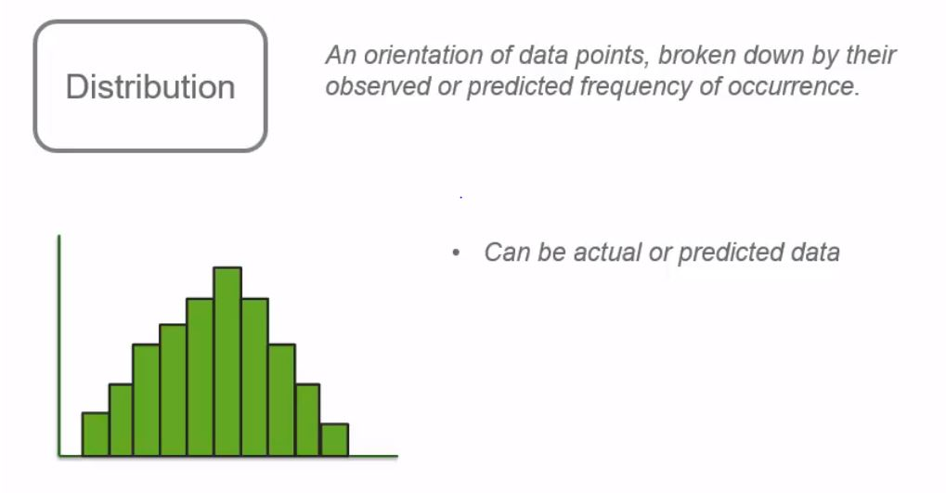
What is distribution?

Slide 4

Actual Distribution

Slide 5
Example
Let us consider an analysis of a test score in a school, which happened before and after the introduction of a specific program, and see if an improvement occurred during the program.
The one way to analyze is by looking the distribution of the data.
Consider the number of total students is 5000.
To start the analyze, perform pre-program and post-program exam to asses the student level.
The test score ranges from 0 to 100.

Slide 6
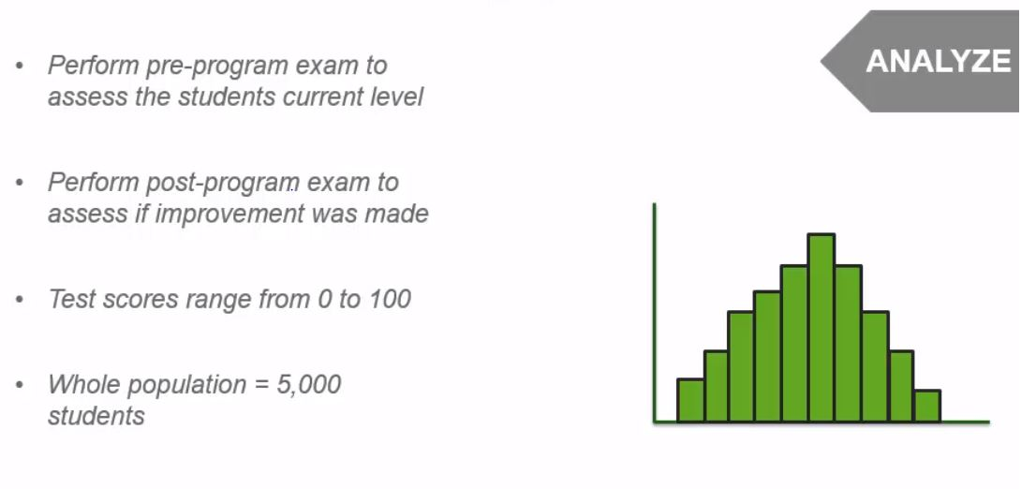
Analyze

Slide 7
Pre-Program results
Let us start by performing a pre-program test and plotting the results on a histogram.
The y-axis will show the number of students
The x-axis will show the bins, in which a range is created from the possible test scores.

Slide 8
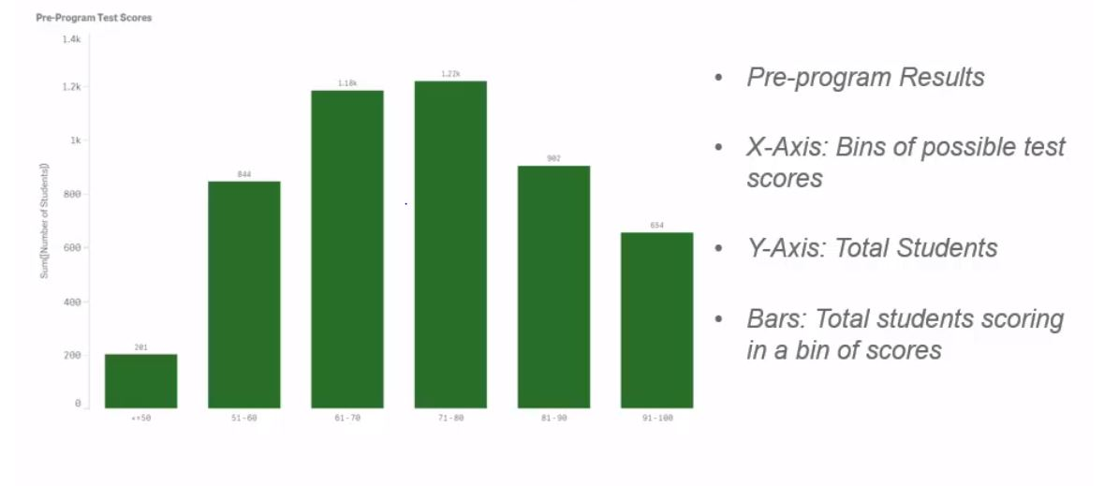
Pre-program graph

Slide 9
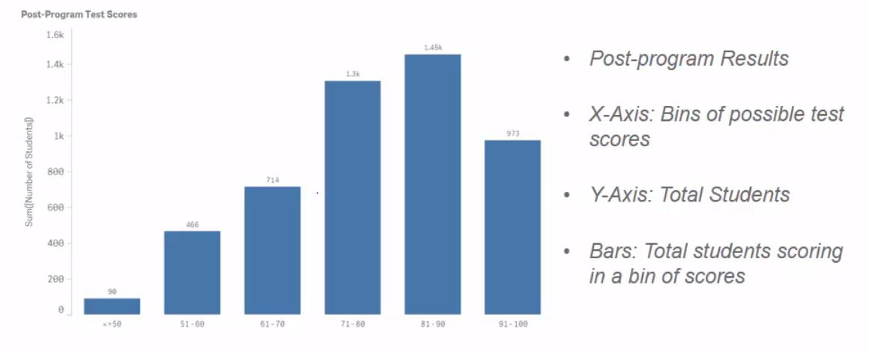
Post-Program results

Slide 10
Comparison
When looking the post-program graph, it is visible that the graph moves towards right and the analysis can be done easily.
Comparing both the chart, the maximum value of y-axis increased from 1400 to 1600, and there is increase in count of 81-90 bin, but he x-axis remains same, which acts as a medium for comparison.
But is this the result of the program? We can hope. But the distribution doesn’t tell us fully.
All this distribution says is, the population moved from left to right and there is a positive impact on the program.
We need to do further analysis on whether this program is the only is the factor for the improvement to happen? Or there is any other factors?

Slide 11
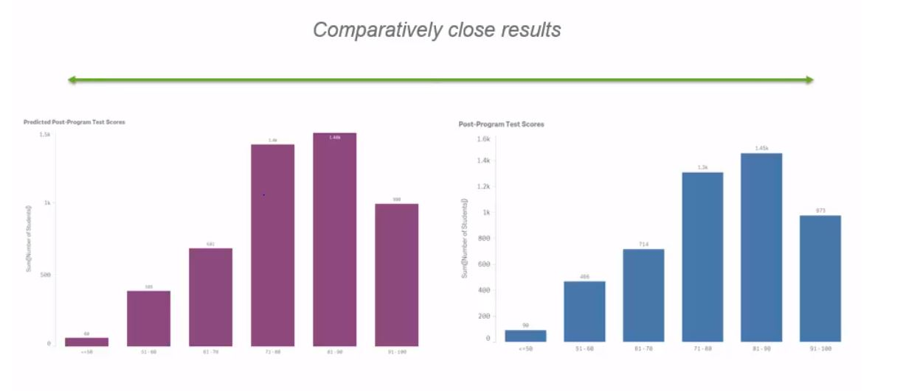
Predicted distribution

Slide 12
Distribution Visualization
The 2 means of visualizations are
Histogram
Box plot

Slide 13
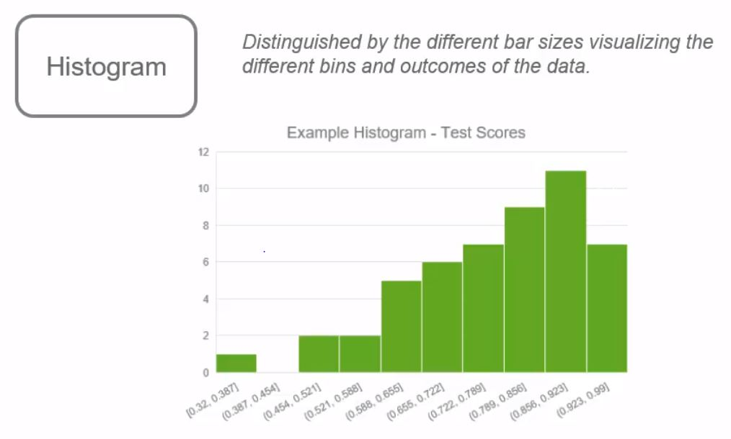
Histogram

Slide 14
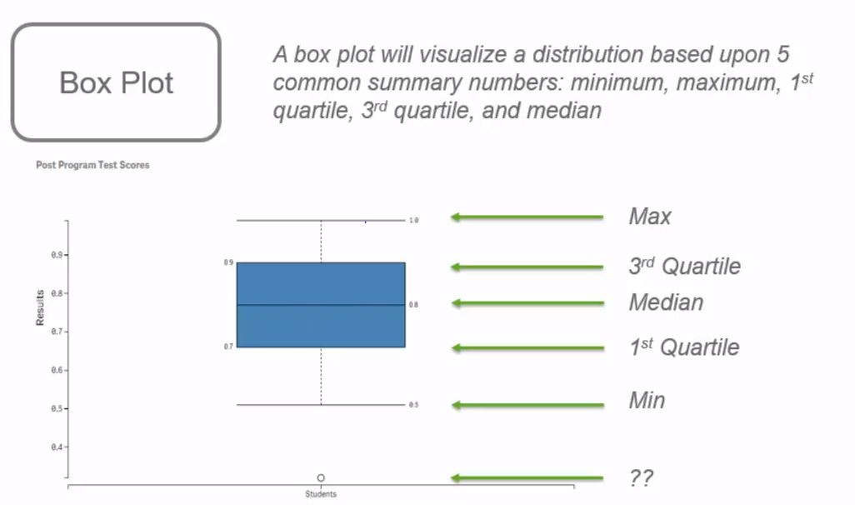
Box plot

Slide 15
Box plot - Outliers
When we see the above example graph for box plot, there is a bubble at the bottom, which has the value of 0.35
That data point is called as outlier.
The outlier is not considered as a minimum point, as only the data points which is found reasonable is included in the graph.
Is that mean the outliers doesn’t matter to our analysis? No. We should still look into it carefully and determine whether it is useful or not.

Slide 16
Way to find outlier
For a data point not to be considered outlier, it has to be fit within the 1.5 times of the length of the box, which is forms by 1st and 3rd quartile.
In the given example, the 1st and 3rd quartile values are 0.7 and 0.9 respectively.
The difference between those 2 quartile is 0.2. So, the next box of the same length that can be formed below the 1st quartile will be of length 0.5 to 0.7.
And another half length of the box can be formed from 0.5 to 0.4. Thus making the qualification mark for the data points to be available between 0.4 to 0.7 below the 1st quartile and the data point 0.35, doesn’t fall on that range.

Slide 17
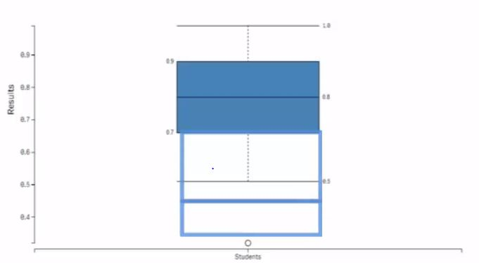
Finding Outlier

Slide 18
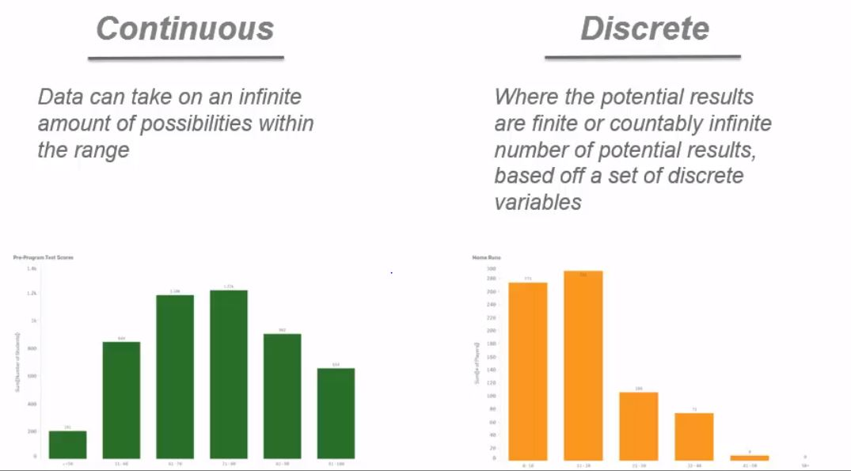
Types of Distribution

Slide 19
Comparison
The continuous distribution contains infinite number of data points. For example, the percentage of a student can be 80.1,80.001,80.011 etc., The decimal point may vary up to infinity.
The Discrete distribution will have values like whole numbers. For example, the variation of runs scored by a player. The score will be 1,2,3 etc., The can’t be scores like 3.2,3.5 etc.,
The number of data points may be large in discrete distribution, but the data value is finite.

Slide 20
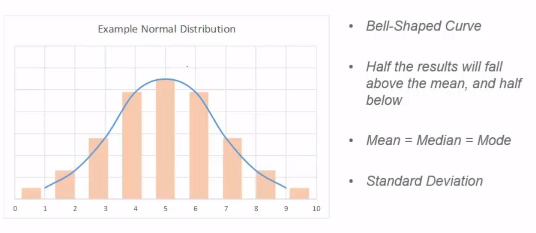
The Normal/Gaussian Distribution

Slide 21
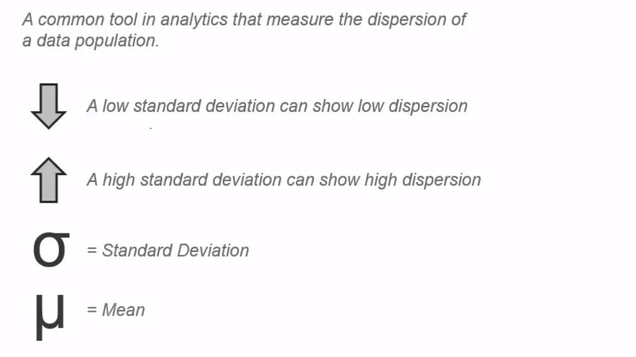
Standard Deviation

Slide 22
Example
Let us consider a distribution data set of weight of a group of people
Consider the mean value is 185 lbs., and the standard deviation is 12 lbs.
1 SD away from the mean is 173 to 197 lbs. 2 SD is 161 to 209 lbs.
While plotting the distribution, it is found that +/- 1 SD will contain 68% of the data and +/- 2 SD will contain 95% of the data.

Slide 23
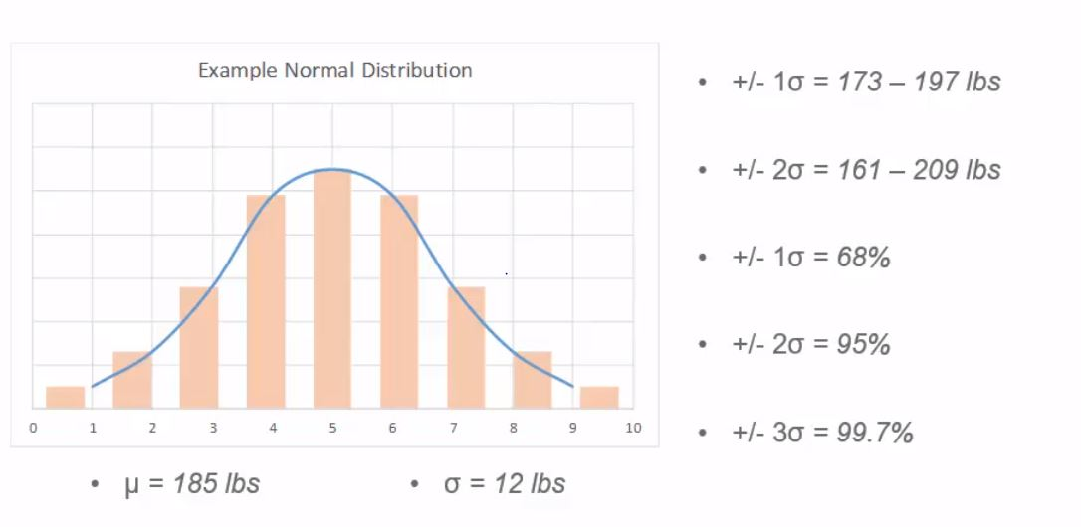
Example

Slide 24
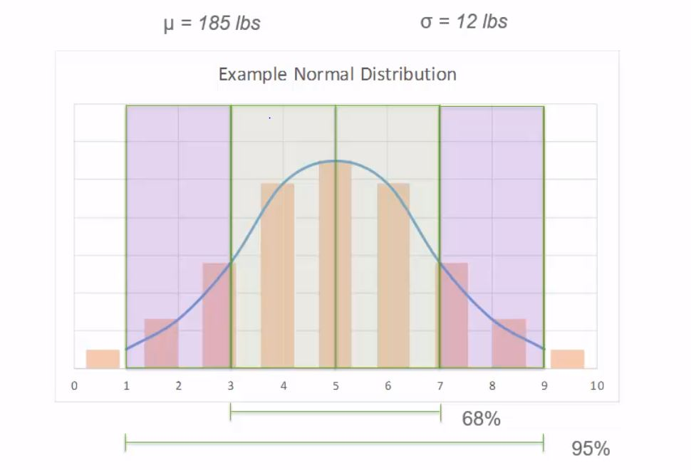

Slide 25
Skewness
Not all the distribution need to be a normal distribution. There maybe a deviation occur, which is called as skewness.
There are 2 types of skewness, right and left.
For the right, mean will be grater than mode and vice versa for the left Skew.

Slide 26
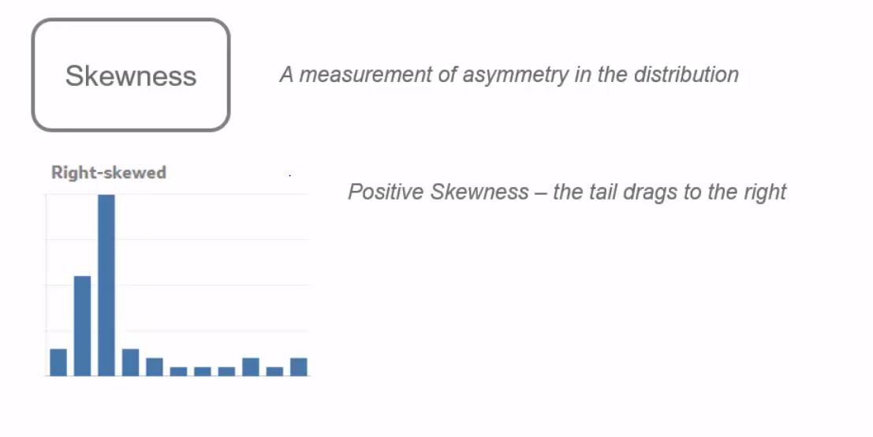
Skewness

Slide 27
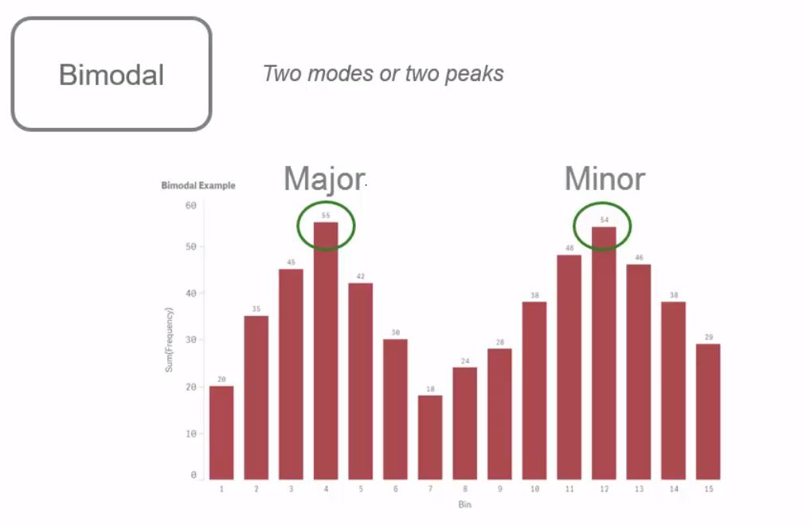
Bimodal Distribution

Slide 28
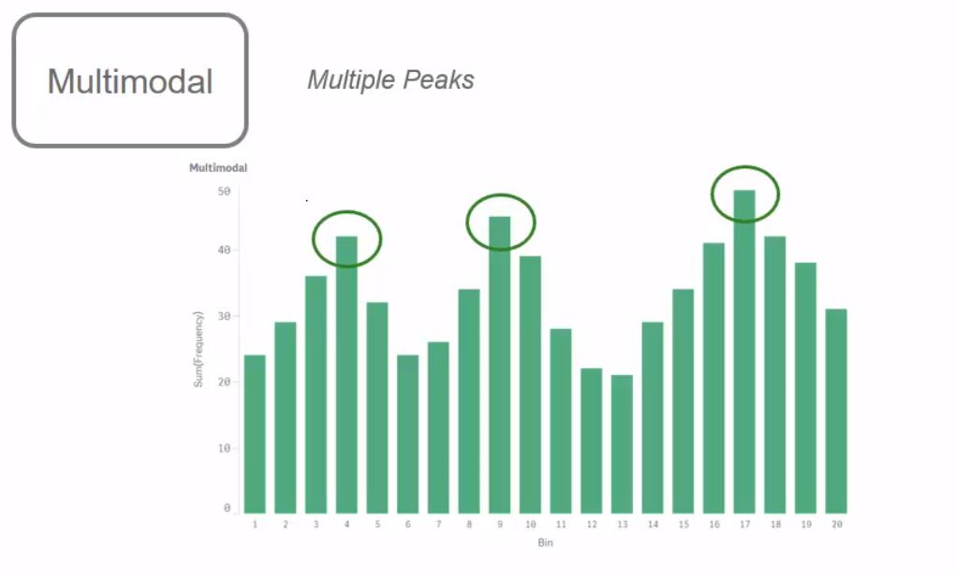
Multimodal Distribution

Slide 29
Quiz
What is a common way that the distribution is visualized?
How many standard deviation will incorporate 95% of Data?
A normal distribution looks like what shape?
A distribution with 2 peaks is called what?

Slide 30
Answers
What is a common way that the distribution is visualized? - Histogram or Box plot
How many standard deviation will incorporate 95% of Data? – 2 SD
A not distribution looks like what shape? – Bell curve
A distribution with 2 peaks is called what? - Bimodal

